Slide 1

Online application system tutorial
KA107 STA and STT mobilities
Erasmus+ mobility between Programme and Partner countries
https://in-staff.dsm.usz.edu.pl/

Slide 2
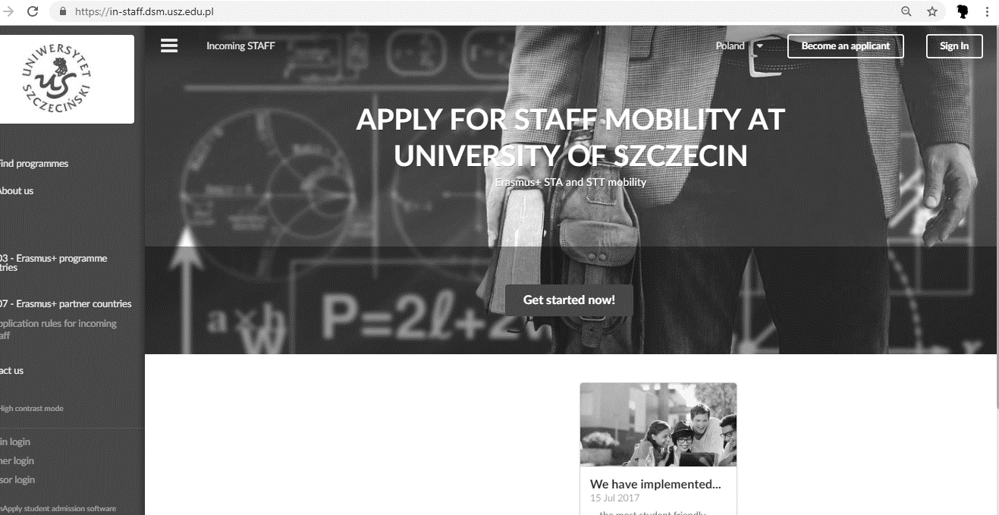

Go to online application system webpage and click on GET STARTED NOW

Slide 3
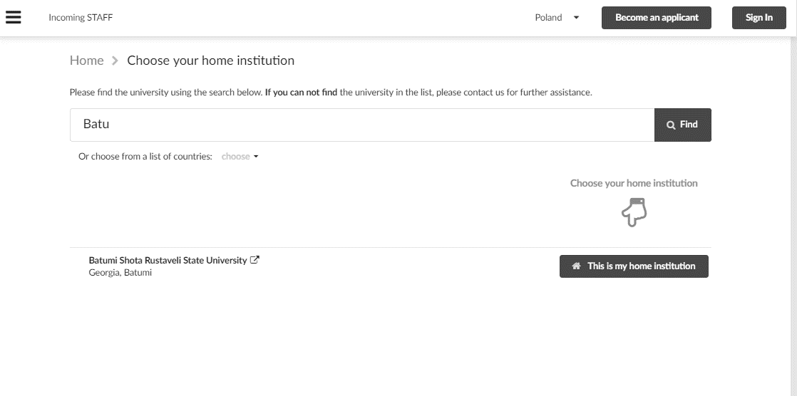
You can either type your university name into search bar or choose from the list.
Click THIS IS MY HOME INSTITUTION to continue

Slide 4
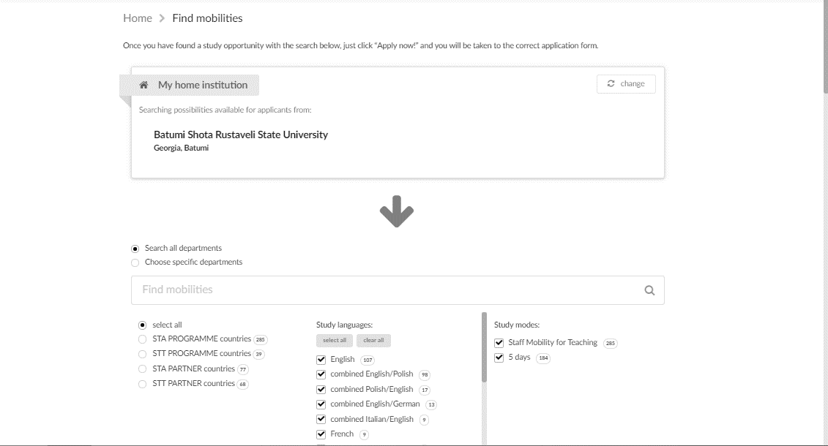
Please, DON’T change „study languages” and „study modes” filters.
If you wish to see all mobility options SELECT ALL.
If you are intersted in specific type of mobility choose either STA PARTNER countries of STT PARTNER countries.

Slide 5
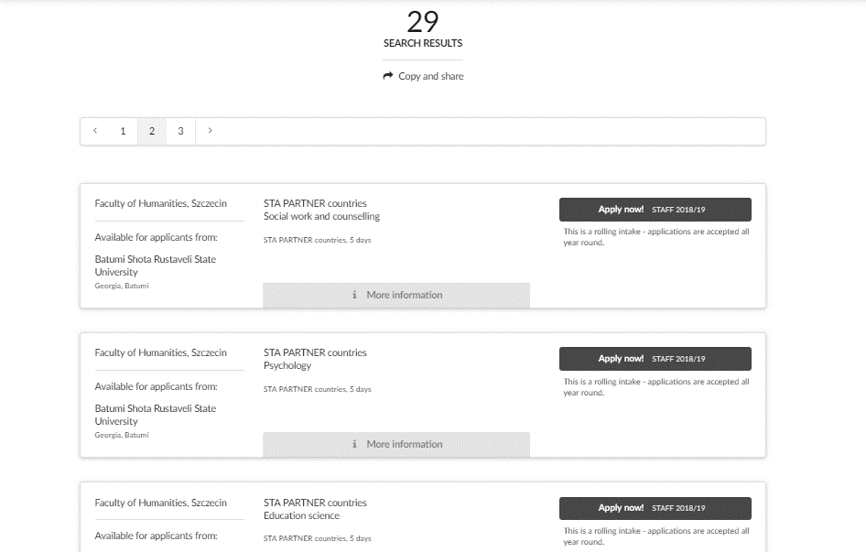
Choose mobility type and study area you are interested in.

Slide 6
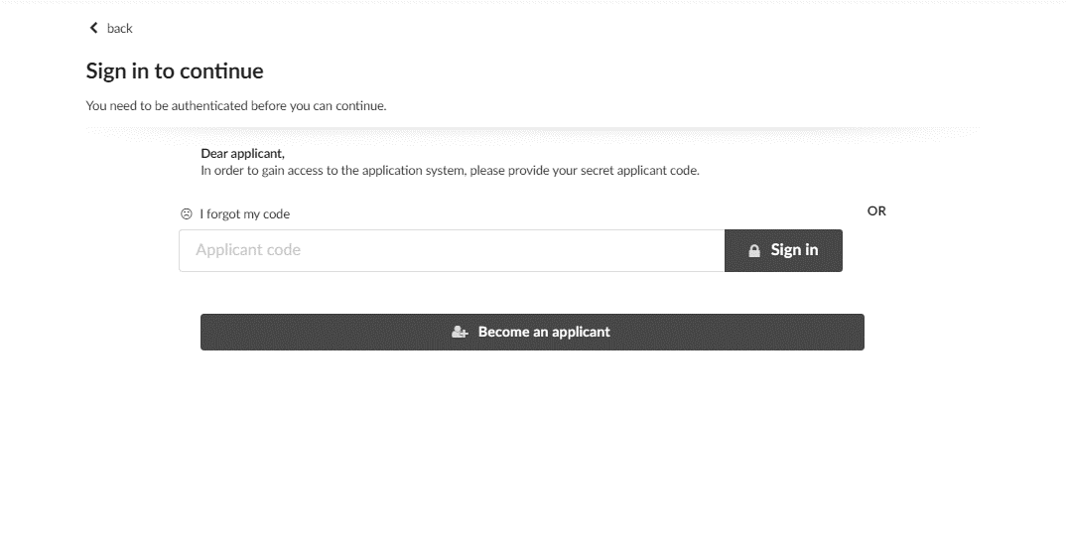
If you apply for the first time click on BECOME AN APPLICANT
If you used this system before click on SIGN IN

Slide 7
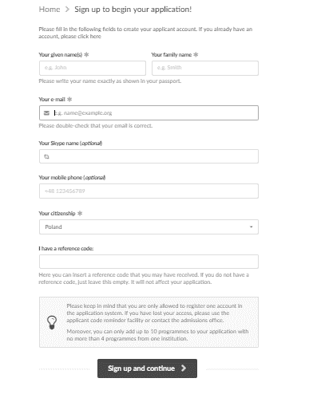
Fill all the mandatory fields in and SIGN UP and CONTINUE

Slide 8
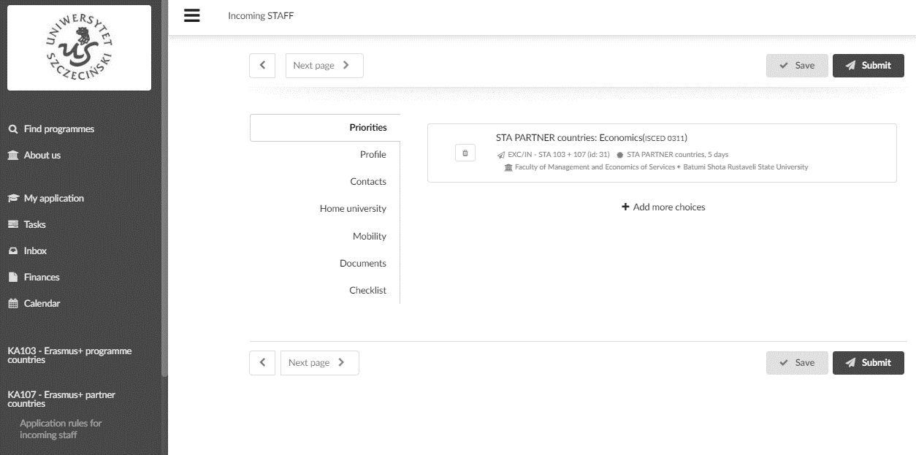
This is your application form, please fill information in all the tabs.
After filling each tab click SAVE.

Slide 9
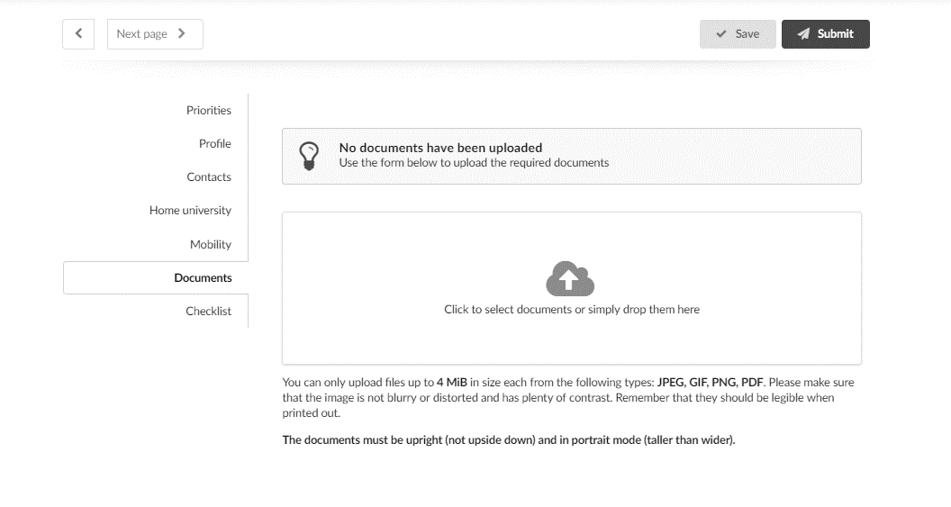
Upload all required documents here, eg. your teaching/training agreement. Don’t forget to SAVE it.
Click SUBMIT when you finish your application.

Slide 10
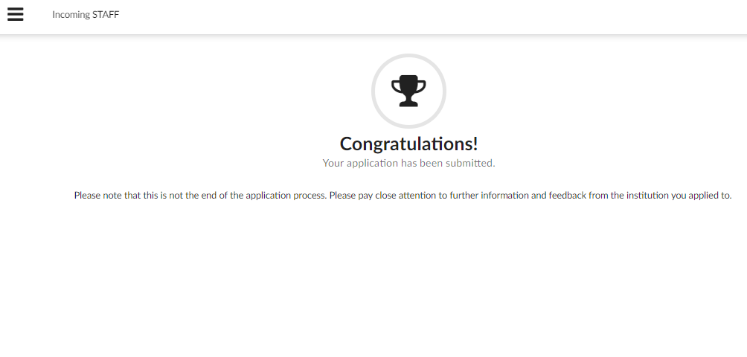
Success!

Slide 11
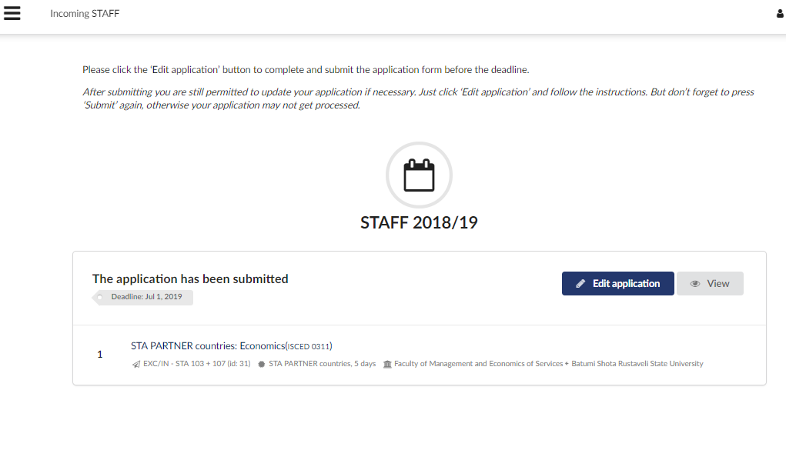
You can always VIEW your application in the left side menu.
If you wish to change something, EDIT APPLICATION

Slide 12
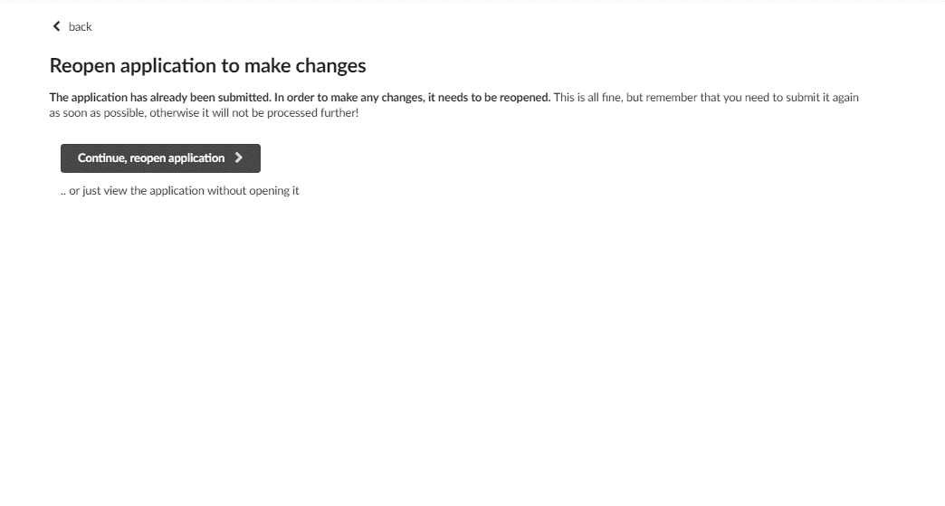
Remember, once you reopen your application, you need to SUBMIT it again,
even if didn’t make any changes.

Slide 13
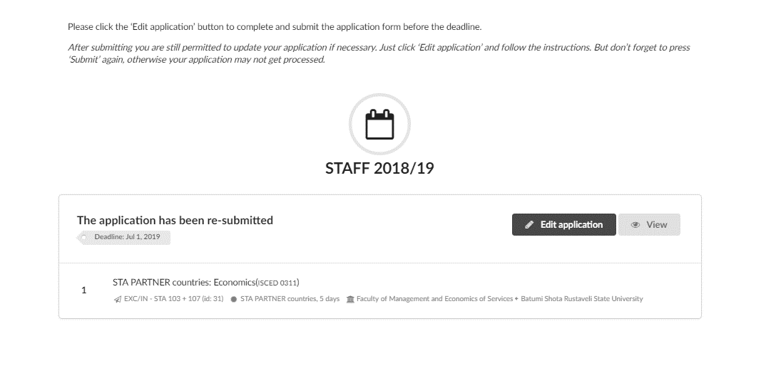
If you reopened and saved your application correctly, you will see information that it was re-submitted.

